Slide 1
Creating a Page Layout with Bootstrap

Slide 2

Overview
Understanding the Bootstrap Grid system
Applying the Bootstrap Grid

Slide 3

Understanding the Bootstrap Grid System

Slide 4

It all started with a table…
Don’t scale well
Most sites use a table-like structure though
Bootstrap uses Grid

Slide 5

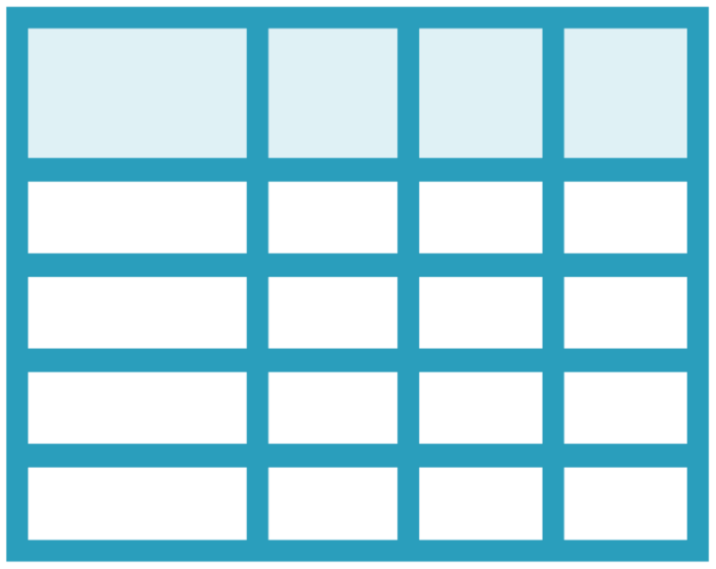
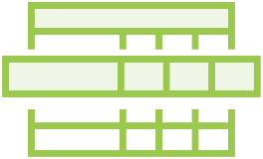

Bootstrap Grid Concepts
Container
Rows and columns
Breakpoints

Slide 6
The Container
<div class="container">
...
</div>
<div class="container-fluid">
...
</div>

Slide 7
Adding Rows
<div class="container">
<div class="row">
</div>
<div class="row">
</div>
</div>

Slide 8
Adding Columns to Rows
<div class="container">
<div class="row">
<div class="col">
of 2
</div>
<div class="col">
of 2
</div>
</div>
<div class="row">
</div>
</div>
2 of 2
1 of 2

Slide 9

Each row has 12 columns
col-xx
Will stack if more are added

Slide 10
Responsiveness Using Breakpoints
Name | Prefix | Width
Extra small | col- | < 576px
Small | col-sm- | >= 576px
Medium | col-md- | >= 768px
Large | col-lg- | >= 992px
Extra large | col-xl- | >= 1200px

Slide 11
Column Naming
<div class="container">
<div class="row">
<div class="col-md-8">
of 2
</div>
<div class="col-md-4">
of 2
</div>
</div>
<div class="row">
</div>
</div>
2 of
2
1 of 2

Slide 12
Column Sizing
 |  | col |  |  |  |  |  | co | l

Slide 13
Column Sizing
 |  | col |  |  |  |  |  | co | l
 | co | l-4 |  |  | col- | 4 |  |  | col-4

Slide 14
Column Sizing
col
col
col-4
col-4
col-4
col-xx-3
col-xx-3
col-xx-6

Slide 15
Column Sizing
col
col
col-4
col-4
col-4
col-xx-3
col-xx-3
col-xx-6
col-xx-2
col-xx-2
col-xx-2
col-xx-2
col-xx-2
col-xx-2

Slide 16
Column Sizing
col
col
col-4
col-4
col-4
col-xx-3
col-xx-3
col-xx-6
col-xx-2
col-xx-2
col-xx-2
col-xx-2
col-xx-2
col-xx-2
col-xx-10
col-xx-2

Slide 17
Combining Column Sizes
Medium and up
<div class="row">
<div class="col-md-8 col-sm-4">
of 2
</div>
<div class="col-md-4 col-sm-8">
of 2
</div>
</div>
2 of
2
1 of 2

Slide 18
Combining Column Sizes
Between small and medium
<div class="row">
<div class="col-md-8 col-sm-4">
of 2
</div>
<div class="col-md-4 col-sm-8">
of 2
</div>
</div>
2 of 2
1 of
2

Slide 19
Combining Column Sizes
Under small
<div class="row">
<div class="col-md-8 col-sm-4">
of 2
</div>
<div class="col-md-4 col-sm-8">
of 2
</div>
</div>
1 of 2
2 of 2

Slide 20
Changing the Order of Columns
<div class="row">
<div class="col-md-2">
of 3
</div>
<div class="col-md-4 order-12 ">
of 3
</div>
<div class="col-md-6 order-1 ">
of 3
</div>
</div>
1 of 3
2 of 3
3 of 3

Slide 21
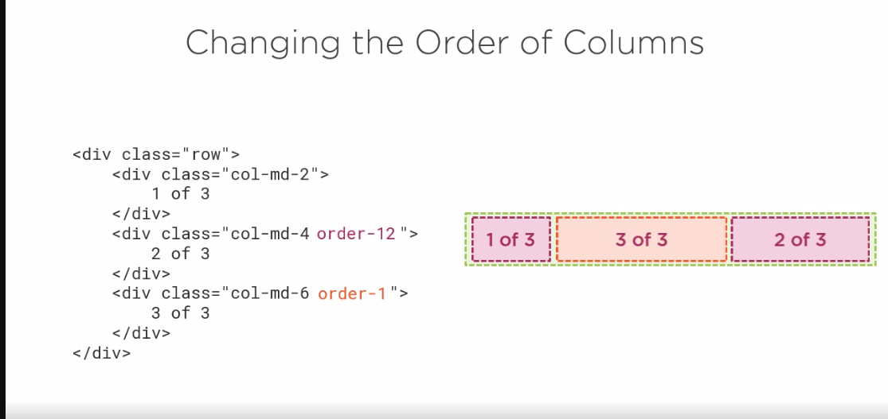

Slide 22
Leaving Some Space
<div class="row">
<div class="col-md-2">
of 2
</div>
<div class="col-md-4 offset-md-6">
of 2
</div>
</div>
1 of 2
2 of 2
offset

Slide 23

Demo
Understanding the grid layout system
Container
Rows
Columns

Slide 24
Demo
Adding responsive layout to the detail page using the grid

Slide 25
Summary
Creating responsive page layouts becomes easy
Based on concept of media queries
Although “limited” to 12 columns, very flexible

Slide 26

Up next:
Adding style with Bootstrap

